Slide 1
Hash Tables

Slide 2
Why and When do we use Hash Tables?
Before understanding hash tables, let us understand the problems of a few simple data structures:
Arrays: Though arrays allow random access, they have a problem that their size is fixed.
Linked list: Linked lists have the advantage that their size can grow dynamically as they do not store elements contiguously. However where they do lack is in the random access to the elements. They require O(n) time to search any element.
Can we perform search in more efficient way than O(n) while still allowing the size to grow dynamically?
Hash tables do offer a solution to that. Hash tables are used when speedy insertion, deletion or searching is a necessity.
What are Hash Tables anyways?
A hash table is just an array coupled with a function known as hash function. Hash function takes an input called key and returns an integer known as the hash value as an output. The hash value maps the key to a particular index in the hash table. We initially use the hash function to determine where in the hash table do we store the key. Latter we use the same hash function to determine where in the hash table do we search for a given key. And hence hash function must be consistent and provide same hash value for identical keys.

Slide 3
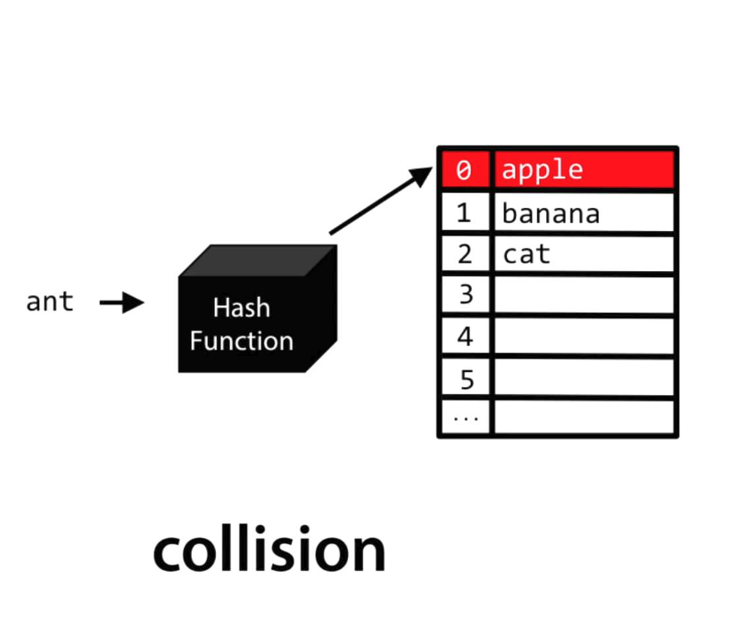
Collision problem can arise in Hash Table. We deal in this case either by probing method or by chaining method.
Consider the following example:
In linear probing we put ant in index 3 of the hash table. In chaining what we do is to make a linked list at each of the 26 indices. The hash table contains pointers to the first element of the linked list. Hence ant now becomes the second element of linked list which has it’s start pointer in the 0th index of hash table.
To avoid collisions which considerably slow down our search, we need to use good hash function. A few characteristics of a good hash function are:
Make use of all information provided by key.
Hash values are uniformly distributed across hash table.
Maps similar keys to very different hash values
Uses only simple operations.

